Slide 1
Dimensionality Reduction
UNIT 2
PCA

Slide 2
Introduction to Dimensionality Reduction
First, let’s start with understanding the simple definition of ‘Dimensionality Reduction’ -
“It is a process of reducing the number of random variables under the consideration by obtaining a set of principal values”

Slide 3
Think as you have many columns in the dataset and many columns are just redundant or not useful in capturing the information that is required in our objective.
We remove such features and by removing it we actually reduce the dimensions of our data.

Slide 4
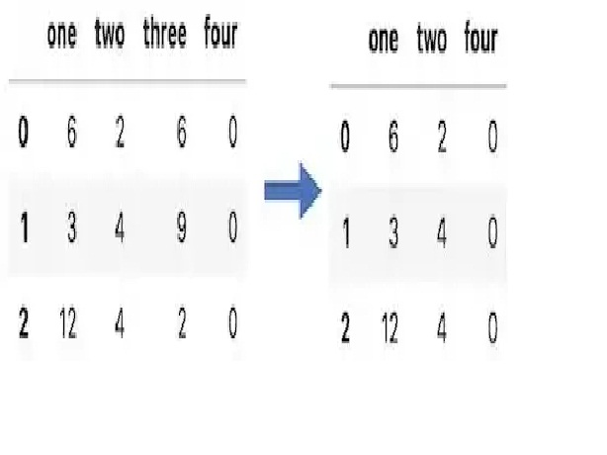
Columns 3 is removed

Slide 5
Main components in Dimensionality Reduction
Feature Selection: In feature selection, we try to find the best subset of features that are required to fulfil our objective.
Feature Extraction: In feature extraction, we create new features based on transformation or combinations of the original feature set.
Note: Both feature selection and extraction leads to dimensionality reduction. No evidence that one of them is superior to other on all types of task.

Slide 6
The Curse of Dimensionality
There are situations when we deal with high dimensional data (Think as thousands of rows and millions of columns) in machine learning.
In such a situation, our machine learning algorithm may not work properly. This situation broadly referred to as “ The Curse of Dimensionality.”

Slide 7
Hughes Phenomena
Since we know that as dimensionality increases, the number of data points to perform good classification/regression/clustering etc. machine learning task increases exponentially
There are some cases where the number of rows (n) of the dataset is fixed and performance decreases as the dimensionality increases. This phenomenon is known as ‘Hughes Phenomena’.

Slide 8
How do we check whether data is high dimensional or not?
There is no proper measure that can be deployed to check the high dimensionality of data.
Since in machine learning a lot of things we decide based on some thumb rule. Here also we will use one thumb rule to decide whether data is high dimensional or not.
Thumb Rule: If data is greater than 2^(No of Columns) will be considered as high dimensional data.

Slide 9
Methods/Algorithms to reduce high dimensionality
There are many methods/algorithms are available to reduce high dimensionality from a dataset. Some of them are mentioned below-
Principal Component Analysis (PCA)
Linear Discriminant Analysis (LDA)
Generalized Discriminant Analysis (GDA)
Dimensionality reduction may be linear or non-linear depending upon the method used.

Slide 10
Prerequisite for Principal Component Analysis (PCA)
Principal Component Analysis (PCA) is nothing but the dimension reduction technique used to reduce the dimensions by forming linear combinations of features which retain maximum information/variance of

Slide 11
concepts that required to understand PCA thoroughly —
Vector (Row & Column)
How to represent dataset as a matrix?
Mean
Variance
Standardization of dataset
Covariance & Covariance Matrix
Eigen Value & Eigen Vectors

Slide 12
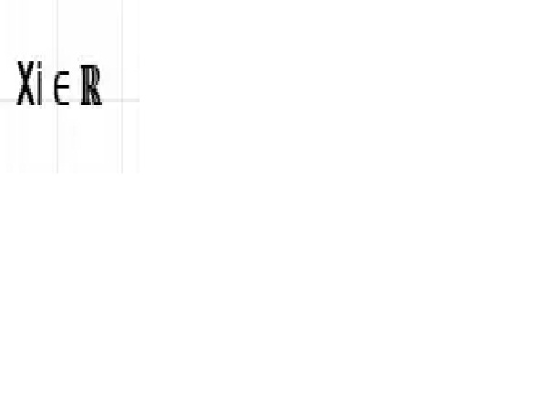
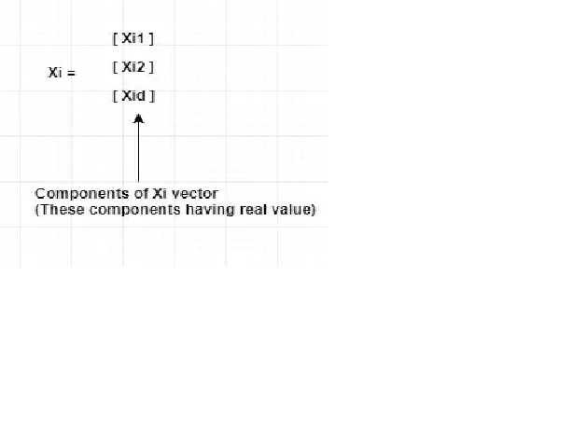
1. Row Vector & Column Vector:
In linear algebra the data points that are real-valued represented as

Slide 13
Each column is considered a vector is known as a column vector. In the above figure, it is clear that Xi is the column vector. (No information is available by default is column vector)
The transpose of a column vector is known as a row vector. Each row in a dataset is considered as a row vector. In the above example, if you take the transpose then we will get a row vector.

Slide 14
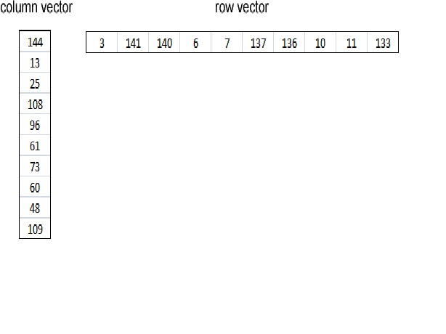
Example: A column vector is on the left side, and a row vector is shown on the right side.

Slide 15
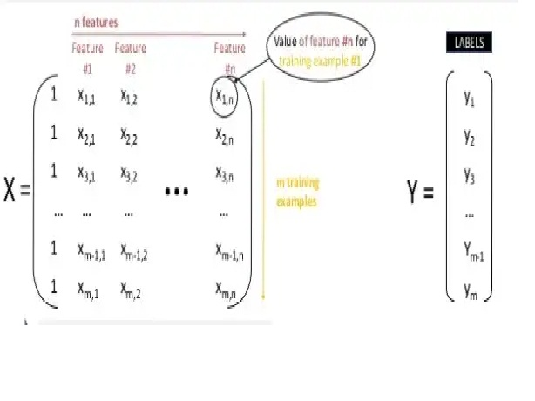
2. How to represent dataset as a matrix:
Each row in the dataset is considered as a data point and each column in the dataset is considered as features.

Slide 16
3. Mean:
The mean is the average of the numbers. It is very easy to calculate: add up all the numbers, then divide how many numbers there are.

Slide 17
Normalization in Machine Learning
Normalization is a scaling technique in Machine Learning applied during data preparation to change the values of numeric columns in the dataset to use a common scale.
It is not necessary for all datasets in a model. It is required only when features of machine learning models have different ranges.

Slide 18
Mathematical formula
we can calculate normalization with the below formula:
Xn = (X - Xminimum) / ( Xmaximum - Xminimum)
Xn = Value of Normalization
Xmaximum = Maximum value of a feature
Xminimum = Minimum value of a feature
Example: Let's assume we have a model dataset having maximum and minimum values of feature as mentioned above.
To normalize the machine learning model, values are shifted and rescaled so their range can vary between 0 and 1. This technique is also known as Min-Max scaling. In this scaling technique, we will change the feature values as follows:

Slide 19
Case1- If the value of X is minimum, the value of Numerator will be 0; hence Normalization will also be 0.
Xn = (X - Xminimum) / ( Xmaximum - Xminimum)
Put X =Xminimum in above formula, we get;
Xn = Xminimum- Xminimum/ ( Xmaximum - Xminimum)
Xn = 0
Case2- If the value of X is maximum, then the value of the numerator is equal to the denominator; hence Normalization will be 1.

Slide 20
Xn = (X - Xminimum) / ( Xmaximum - Xminimum)
Put X =Xmaximum in above formula, we get;
Xn = Xmaximum - Xminimum/ ( Xmaximum - Xminimum)
Xn = 1
Case3- On the other hand, if the value of X is neither maximum nor minimum, then values of normalization will also be between 0 and 1.
Hence, Normalization can be defined as a scaling method where values are shifted and rescaled to maintain their ranges between 0 and 1, or in other words; it can be referred to as Min-Max scaling technique.

Slide 21
When to use Normalization or Standardization?
Which is suitable for our machine learning model, Normalization or Standardization?. both terms have the almost same meaning choice of using normalization or standardization will depend on your problem and the algorithm you are using in models.

Slide 22
1. Normalization is a transformation technique that helps to improve the performance as well as the accuracy of your model better. Normalization of a machine learning model is useful when you don't know feature distribution exactly.
In other words, the feature distribution of data does not follow a Gaussian (bell curve) distribution. Normalization must have an abounding range, so if you have outliers in data, they will be affected by Normalization.
Further, it is also useful for data having variable scaling techniques such as KNN, artificial neural networks. Hence, you can't use assumptions for the distribution of data.

Slide 23
Standardization
2. Standardization in the machine learning model is useful when you are exactly aware of the feature distribution of data or, in other words, your data follows a Gaussian distribution. However, this does not have to be necessarily true.
Unlike Normalization, Standardization does not necessarily have a bounding range, so if you have outliers in your data, they will not be affected by Standardization.
Further, it is also useful when data has variable dimensions and techniques such as linear regression, logistic regression, and linear discriminant analysis.

Slide 24
Example: Let's understand an experiment where we have a dataset having two attributes, i.e., age and salary. Where the age ranges from 0 to 80 years old, and the income varies from 0 to 75,000 dollars or more. Income is assumed to be 1,000 times that of age. As a result, the ranges of these two attributes are much different from one another.

Slide 25
Because of its bigger value, the attributed income will organically influence the conclusion more when we undertake further analysis, such as multivariate linear regression. However, this does not necessarily imply that it is a better predictor. As a result, we normalize the data so that all of the variables are in the same range.

Slide 26
Further, it is also helpful for the prediction of credit risk scores where normalization is applied to all numeric data except the class column. It uses the tanh transformation technique, which converts all numeric features into values of range between 0 to 1.

Slide 27
This technique is helpful for various machine learning algorithms that use distance measures such as K-means clustering, and Principal component analysis, etc.
Further, it is also important that the model is built on assumptions and data is normally distributed.

Slide 28
4. Variance & Standard Deviation:
The variance is defined as-
“The average of the squared differences from the mean”
The variance tells us how much your data has spread out from the mean of the dataset.
Once we have variance we can easily calculate a standard deviation once we have variance. Standard deviation is nothing but the square root of the variance.

Slide 29
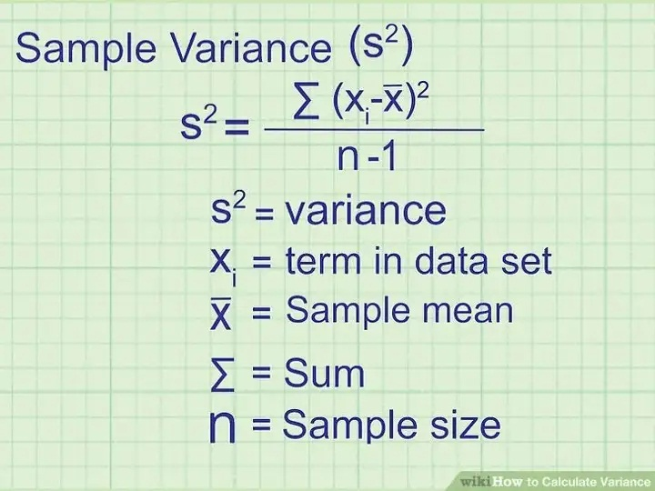

Slide 30

Standardization
Standardization scaling is also known as Z-score normalization, in which values are centered around the mean with a unit standard deviation, which means the attribute becomes zero and the resultant distribution has a unit standard deviation. Mathmatically, Standardization
Here, µ represents the mean of feature value, and σ represents the standard deviation of feature values.

Slide 31
5. Standardization of Dataset:
Sometimes many features come with different scales.
It means these variables or feature do not give an equal contribution to the analysis. Let’s say you’ve two variables height(cm) of the student and weight (KG).
Since both the variable are having different scales cause a serious issue in our analysis.
When we standardize variable we make sure that the mean of the feature is 0 and the standard deviation is equal to 1. By doing this we can get rid of scales.

Slide 32
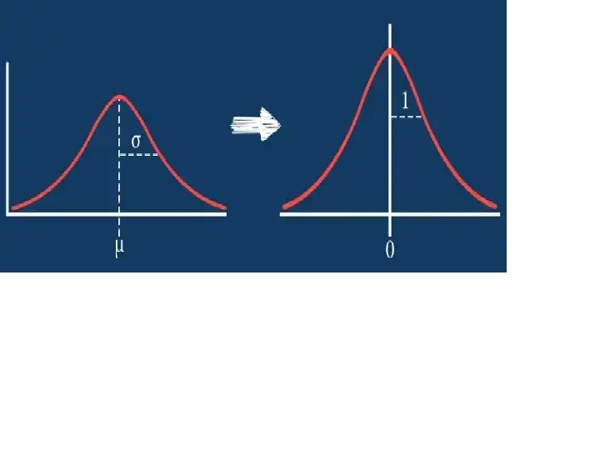

Slide 33
How do we standardize our data?
Z-score standardization is one of the most popular methods to normalize data. In this case, we rescale an original variable to have a mean of zero and a standard deviation of one.

Slide 34
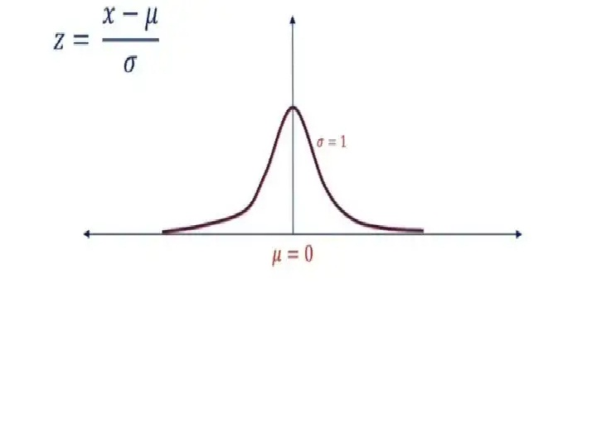

Slide 35
When we normalize using the Standard score as given below, it’s also commonly known as Standardization or Z-Score.
More about Z-Score
The z score tells us how many standard deviations away from the mean your score is.
For example —
Z-score of 1.5 then it implies it’s 1.5 standard deviations above the mean.
Z-score of -0.8 indicates our value is 0.8 standard deviations below the mean.

Slide 36
Normalization Vs Standardization
Normalization | Standardization
This technique uses minimum and max values for scaling of model. | This technique uses mean and standard deviation for scaling of model.
It is helpful when features are of different scales. | It is helpful when the mean of a variable is set to 0 and the standard deviation is set to 1.
Scales values ranges between [0, 1] or [-1, 1]. | Scale values are not restricted to a specific range.
It got affected by outliers. | It is comparatively less affected by outliers.
Scikit-Learn provides a transformer called MinMaxScaler for Normalization. | Scikit-Learn provides a transformer called StandardScaler for Normalization.
It is also called Scaling normalization. | It is known as Z-score normalization.
It is useful when feature distribution is unknown. | It is useful when feature distribution is normal.

Slide 37
6. Covariance & Covariance Matrix:
Covariance is one of a family statistical measures used to analyse the linear relationship between two variables.
How do two variables behave as a pair? Covariance can take any value between -Inf to +Inf.
A positive value indicates an increasing linear relationship and a negative value indicates a decreasing relationship.
Covariance near to ZERO indicates no relationship between the variables.

Slide 38
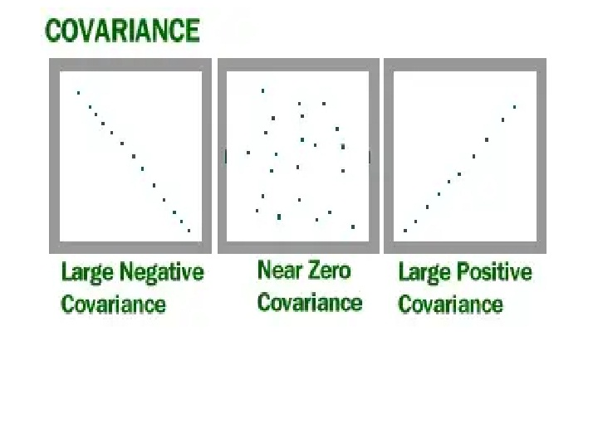
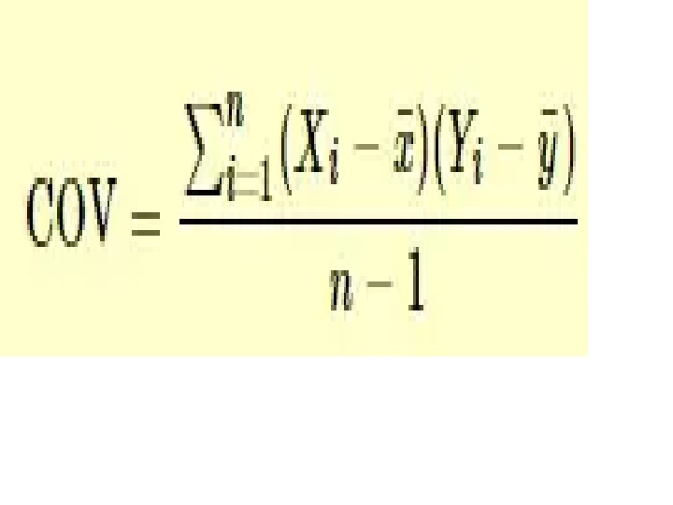

Slide 39
How to calculate COV(X, Y)
Note: Covariance does not tell you about ‘Strength of relationship’. It just tells you whether there is a positive or negative linear relationship exists or not.
Covariance Matrix:A covariance matrix is nothing but the information about auto-covariance (Covariance with itself) and Covariance between two different variables presented in matrix format as shown below-

Slide 40
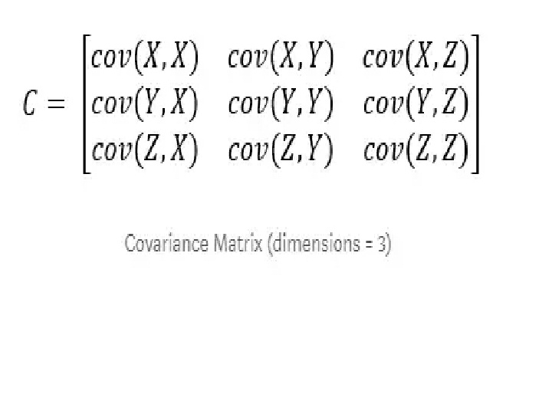
Covariance Matrix

Slide 41
If you observe the above matrix carefully you can see all diagonal elements are nothing but the covariance with itself. These are also called variance of the variable. Thus we can say,
Cov(X,X) = Var(X) | Cov(Y,Y) = Var(Y) | Cov(Z,Z) = Var(Z)

Slide 42
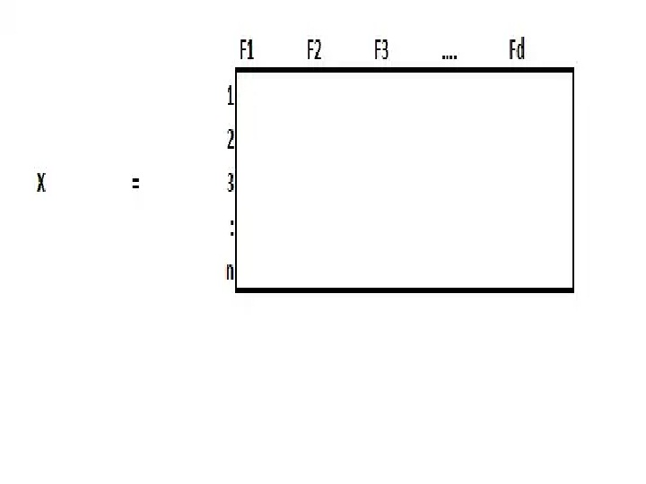

Slide 43
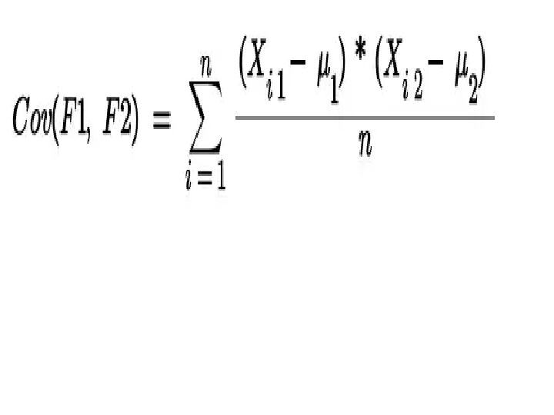
Let’s calculate the covariance of two columns COV(F1, F2) to understand the concept that we discussed above in a better way.
Covariance Between 2 Features

Slide 44
where,
Xi1 : Data points of F1 | Xi2 : Data points of F2 | μ1 & μ2: Mean of the respective columns.
Lets assume data is standardized which means μ = 0 & σ = 1. Therefore the above equation becomes-

Slide 45
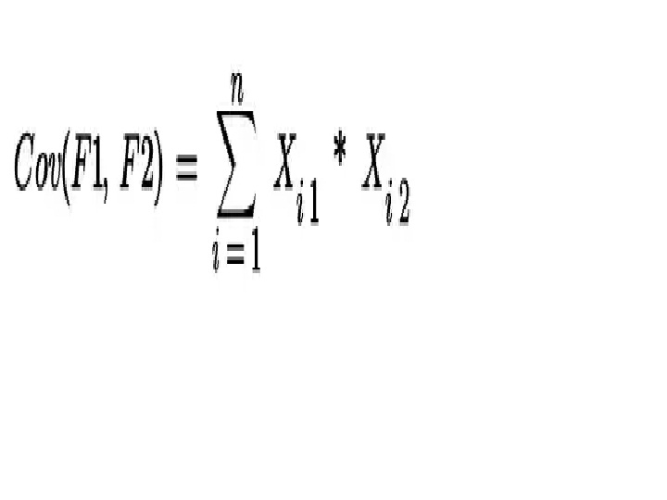
Covariance when μ = 0 & σ = 1
Therefore,

Slide 46
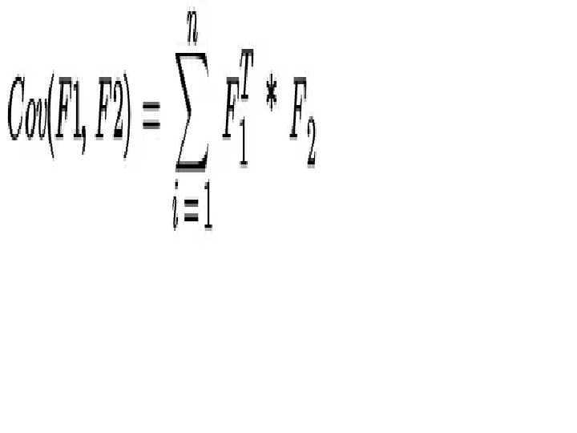

Slide 47
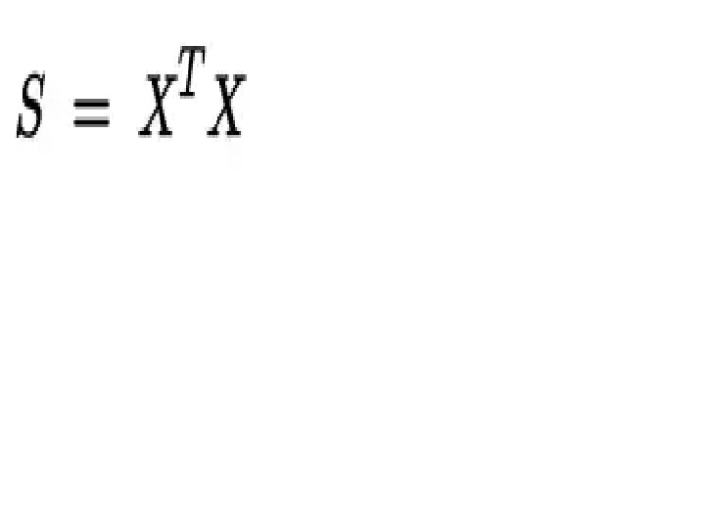
Thus we can generalize it like below
Covariance Matrix
where S = Covariance Matrix | X = Datapoints

Slide 48
7. Eigen Value & Eigen Vector
The word ‘Eigen’ is taken from ‘German’ which means ‘Self or own’. It describes a special relationship between two things.
For example, “mein eigenes Auto” in German means “My Own Car”. Here eigen is explaining the relationship between ‘car and my own’. Thus we can think of the same relationship of eigenvectors with a square matrix.
In the world of linear algebra, all the square matrix (for example, 2x2 or 4x4)have eigenvectors associated with them.

Slide 49
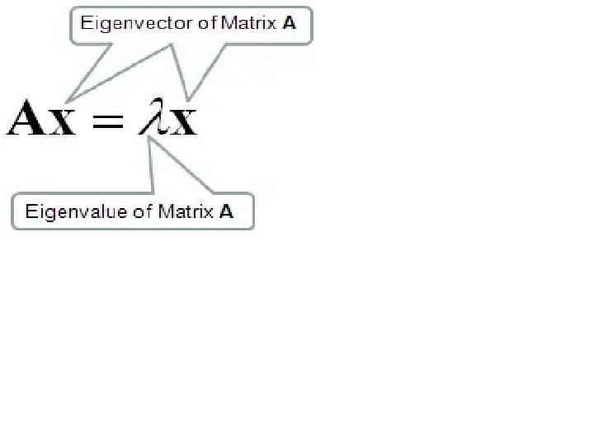
Let A be the square matrix of order (n x n), then a number (Real or Complex) λ is said to be the eigenvalue of matrix A if there exists a column matrix x of order (n x 1) such that -

Slide 50
Therefore,
Ax -λx = 0
(A-λI)x = 0
where I = Identity matrix.
In order to find eigenvalues and eigenvectors first, we need to convert the above equation to a characteristic equation -
| A-λI | = 0 …..(Characteristic Equation)
Here basically we are subtracting λ value from the diagonal of the square matrix A then we are taking the determinant of the resulting matrix.
Thus the solution to the characteristic equation will give you eigenvalues.

Slide 51
Note: Total number of eigenvalues is same as an order of square matrix. Let say we have 2 x 2 data matrix then there will be 2 eigenvalues. And we find eigenvectors corrosponding to eigenvalues.
Once we get λ value by using the above equation then put the value of λ in the equation (A-λI)x = 0 to get the corresponding eigenvector.

Slide 52
Important Pointers
If you multiply matrix A with vector X then we will get another vector where we can say matrix performed linear transformation on an input vector
An eigenvector is a vector whose direction remains unchanged when a linear transformation is applied to it.

Slide 53
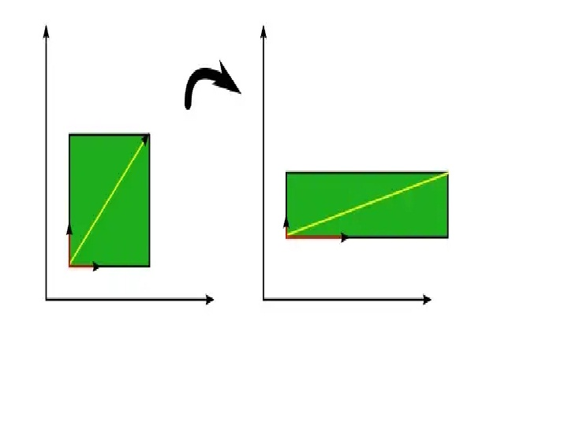
Eigenvectors (red) do not change direction when a linear transformation (e.g. scaling) is applied to them. Other vectors (yellow) do.
The green square is only drawn to illustrate the linear transformation that is applied to each of these three vectors.

Slide 54
3. Here square matrix is nothing but our calculated covariance matrix and we are using that to find eigenvalues and eigenvectors.
Let S be the covariance matrix then corresponding eigenvalue and eigenvectors are -
Eigenvalues(S) = λ 1≥ λ2 ≥ λ3 ≥ … ≥ λd
Eigenvectors(S)= V1 ≥ V2 ≥ V3 ≥ … ≥ Vd
Where λ1 = Maximal eigenvalue (means maximum variance) & V1 is an eigenvector corresponding to maximal eigenvalues

Slide 55
Thus we can say,
Vi ⊥ Vj = Vi * Vj = ||Vi|| * ||Vj||* cos ϴ
Since Vi ⊥ Vj then cos ϴ = cos 90 = 0
Vi ⊥ Vj = Transpose(Vi) * Vj = 0
Therefore, every pair of the eigenvector is ⊥ to each other.

Slide 56
4. The eigenvector is a vector with the direction of maximum variance and eigenvalue is the number (scalar) which represent maximum variance.

